Slide 1
Building modular applications with native Javascript (for Java developers)
Emanuil Stefanov Glavchev
Senior Professional Programmer Analyst at DXC Technology

Slide 2


A bit about me
Work history:
FINTECH at Eurorisksystems, Varna (2.5 years)
FLIGHT TICKETING in Vayant, Sofia (2.5 years)
… and back to FINTECH with DXC, Varna (3 and counting)
Hobbies
Piano
Mathematics
Shaders and other styles of visual programming
Wood carving
Drawing
…and Javascript shenanigans

Slide 3
Goal of this presentation
Why “for Java developers”?
Need for structure and convention (or when too much freedom gets in the way)
Not a framework guide!

Slide 4

My approach to Javascript
Main heroes in this story:
the mighty Function
the plain JS object (not in its full glory)

Slide 5
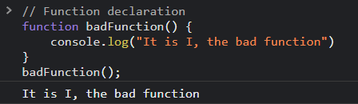
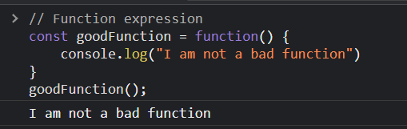
Javascript prerequisites The Javascript function

Slide 6
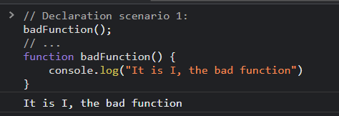
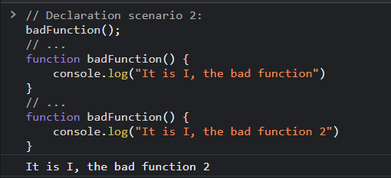
Javascript prerequisites The Javascript function

Slide 7
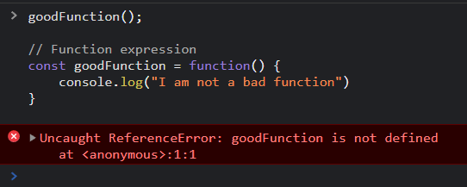
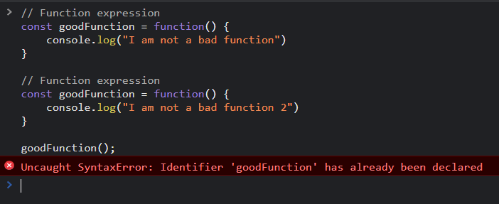
Javascript prerequisites The Javascript function

Slide 8
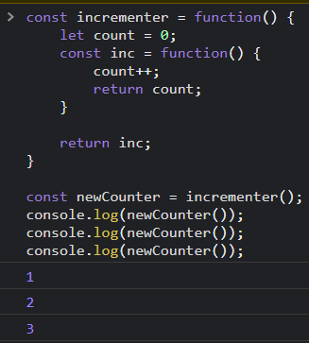
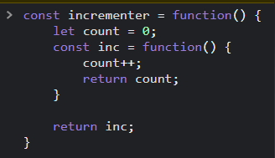
Javascript prerequisites The Javascript function

Slide 9
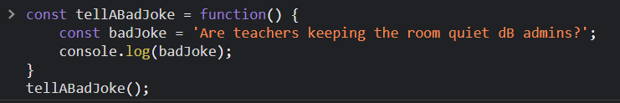

Javascript prerequisites Scoping with functions

Slide 10
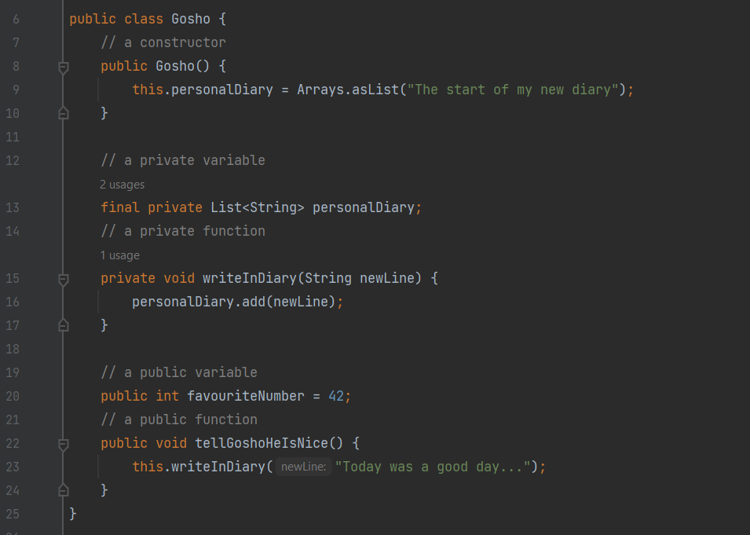
What is a Javascript module?
What is a Java class?
constructor
hidden state
public interface

Slide 11
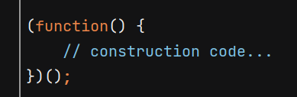
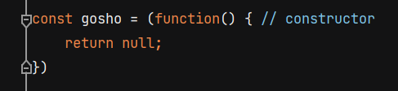
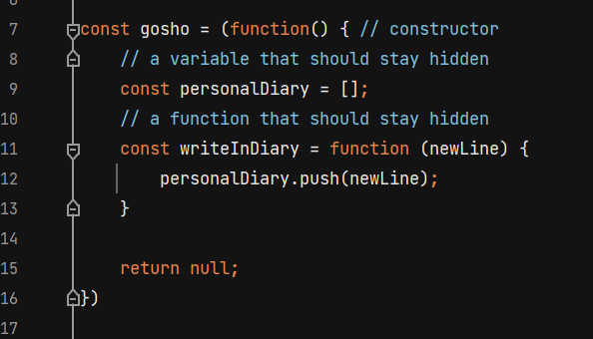
What is a Javascript module?
Let’s build a module!

Slide 12
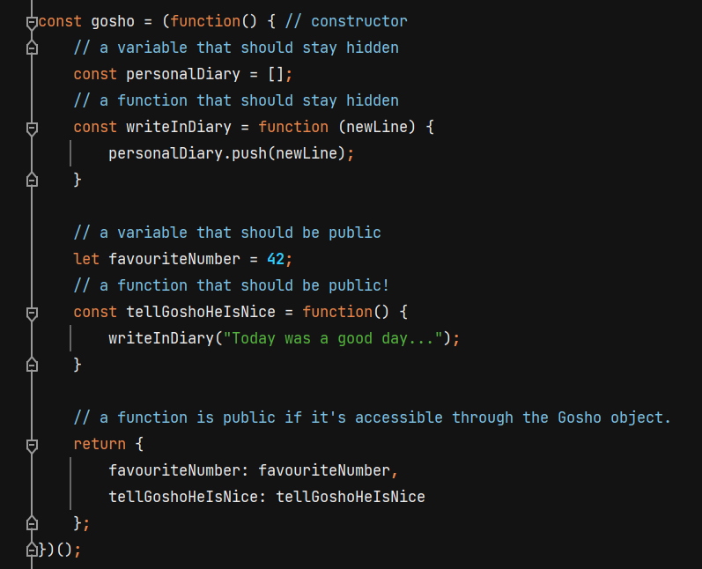
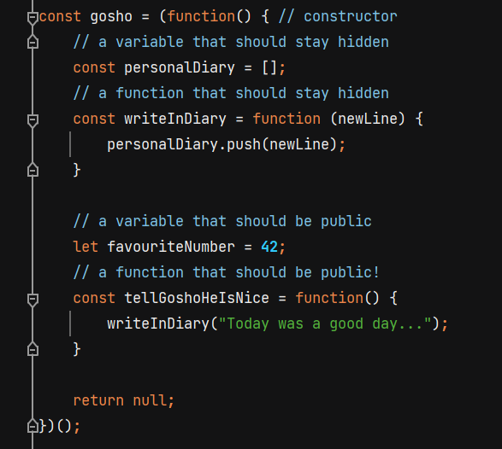
What is a Javascript module?
Let’s build a module!

Slide 13
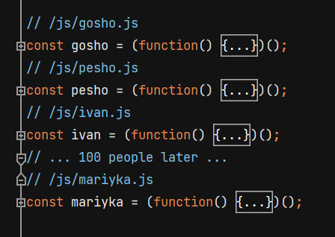
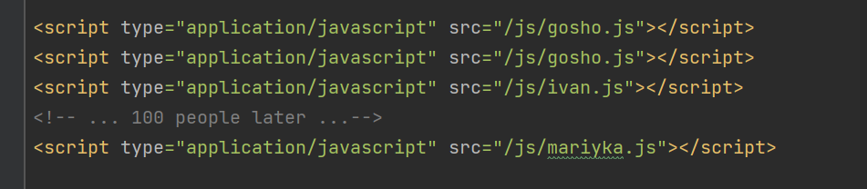
Problems remaining
Clutter!!!
Double declaration…

Slide 14
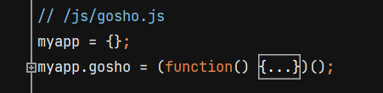
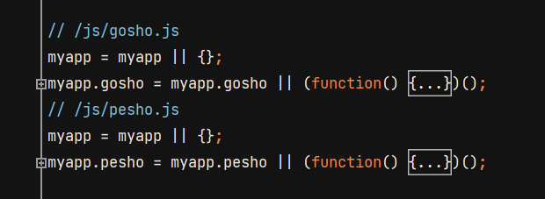
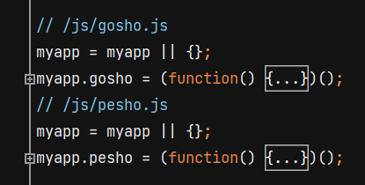
Registries and namespaces
Group modules into the application namespace!
Clutter is solved! So is double declaration!

Slide 15
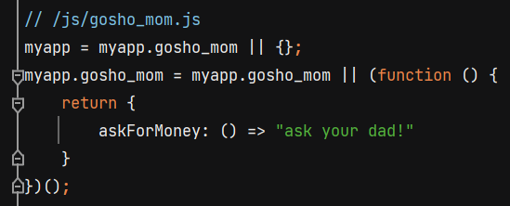
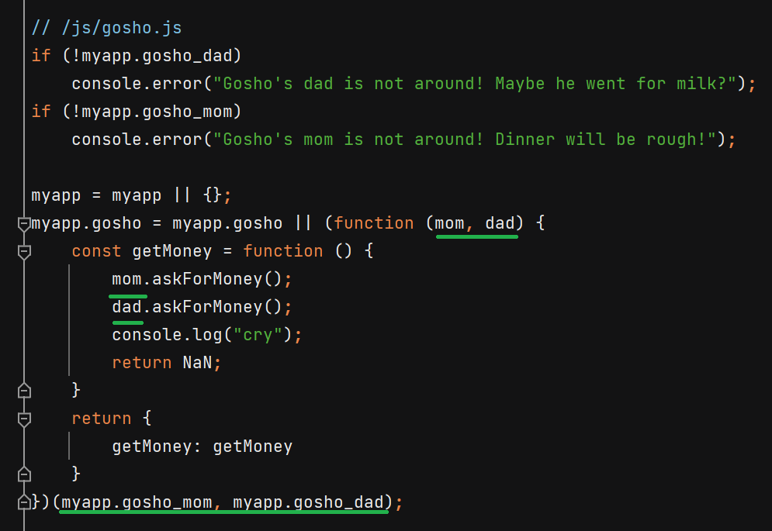
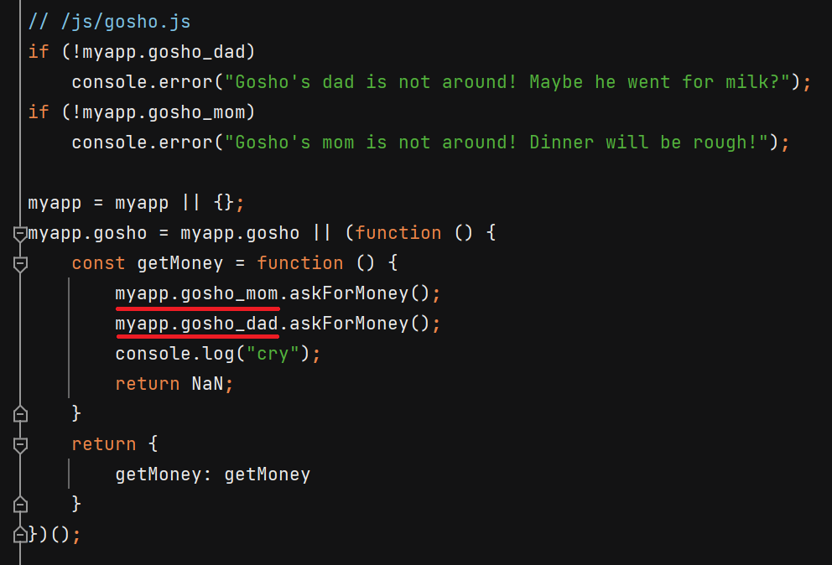
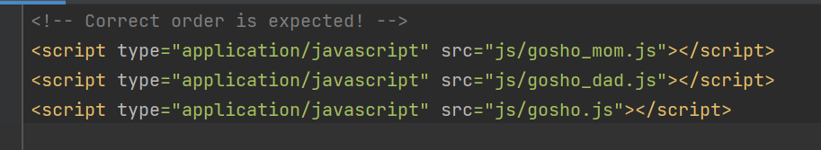
Dependency management
Example manual approach:

Slide 16
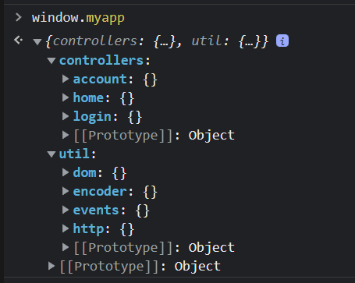
Runtime advantages of modular frontend code
The usual suspects:
code is easy to reuse
code is split into units with well-defined interfaces and dependencies
Modules are easy to access during runtime and can also be arranged on the namespace object in a structure that makes more sense:
controllers (each js corresponding to a web page)
shared utility modules

Slide 17
Runtime advantages of modular frontend code
Troubleshooting paradise!
LIVE state of application can be explored
Actively design your modules around this feature!

Slide 18
Dependency injection options
DI challenge 1:
All module files register an object with their constructor, name and list of dependency names.
Then using this data build a dependency manager that can query this registry and instance a module with its dependencies
Bonus challenge: Make it work with cyclic dependencies
DI challenge 2:
Dependency manager is the only module present initially. Whenever a module is requested from it, if it’s present and instanced, it is returned, else it is fetched with an AJAX query and built (and then its dependencies, if needed)
Bonus challenge: Make it work with cyclic dependencies
Build-time DI

Slide 19
JS frameworks and why native JS matters

Slide 20
Application in the life of a Java webapp developer
framework independence
no need for full adoption
backend agnostic
cross-application drag-n-drop utilities (almost)

Slide 21
Thank you for the opportunity to present
Email: fantasmo3@gmail.com
Phone: Samsung

